Slide 1
Module 2: Basic Switch and End Device Configuration
Instructor Materials
Introduction to Networks v7.0 (ITN)
Notes:
Cisco Networking Academy Program
CCNA 1
Module 2: Basic Switch and End Device Configuration

Slide 2
Instructor Materials – Module 2 Planning Guide
This PowerPoint deck is divided in two parts:
Instructor Planning Guide
Information to help you become familiar with the module
Teaching aids
Instructor Class Presentation
Optional slides that you can use in the classroom
Begins on slide #13
Note: Remove the Planning Guide from this presentation before sharing with anyone.
For additional help and resources go to the Instructor Home Page and Course Resources for this course. You also can visit the professional development site on netacad.com, the official Cisco Networking Academy Facebook page, or Instructor Only FB group.
Notes:
2

Slide 3
What to Expect in this Module
To facilitate learning, the following features within the GUI may be included in this module:
Feature | Description
Animations | Expose learners to new skills and concepts.
Videos | Expose learners to new skills and concepts.
Check Your Understanding(CYU) | Per topic online quiz to help learners gauge content understanding.
Interactive Activities | A variety of formats to help learners gauge content understanding.
Syntax Checker | Small simulations that expose learners to Cisco command line to practice configuration skills.
PT Activity | Simulation and modeling activities designed to explore, acquire, reinforce, and expand skills.

Slide 4
What to Expect in this Module (Cont.)
To facilitate learning, the following features may be included in this module:
Feature | Description
Hands-On Labs | Labs designed for working with physical equipment.
Class Activities | These are found on the Instructor Resources page. Class Activities are designed to facilitate learning, class discussion, and collaboration.
Module Quizzes | Self-assessments that integrate concepts and skills learned throughout the series of topics presented in the module.
Module Summary | Briefly recaps module content.

Slide 5
Check Your Understanding
Check Your Understanding activities are designed to let students quickly determine if they understand the content and can proceed, or if they need to review.
Check Your Understanding activities do not affect student grades.
There are no separate slides for these activities in the PPT. They are listed in the notes area of the slide that appears before these activities.
Notes:
5

Slide 6
Module 2: Activities
What activities are associated with this module?
Page # | Activity Type | Activity Name | Optional?
2.1.6 | Check Your Understanding | Cisco IOS Access | Recommended
2.2.3 | Video | IOS CLI Primary Command Modes | Recommended
2.2.5 | Video | Navigate Between IOS Modes | Recommended
2.2.7 | Syntax Checker | Navigate Between IOS Modes | Recommended
2.2.8 | Check Your Understanding | IOS Navigation | Recommended
2.3.4 | Video | Context Sensitive Help and Command Syntax Check | Recommended
2.3.6 | Video | Hot Keys and Shortcuts | Recommended
2.3.7 | Packet Tracer | Navigate the IOS | Recommended
Notes:
6

Slide 7
Module 2: Activities (Cont.)
What activities are associated with this module?
Page # | Activity Type | Activity Name | Optional?
2.3.8 | Lab | Navigate the IOS by Using Tera Term for Console Connectivity | Recommended
2.4.6 | Video | Secure Administrative Access to a Switch | Recommended
2.4.7 | Syntax Checker | Basic Device Configuration | Recommended
2.4.8 | Check Your Understanding | Basic Device Configuration | Recommended
2.5.3 | Video | Alter the Running Configuration | Recommended
2.5.5 | Packet Tracer | Configure Initial Switch Settings | Recommended
2.6.3 | Check Your Understanding | Ports and Addresses | Recommended
2.7.3 | Syntax Checker | Verify Windows PC IP Configuration | Recommended
Notes:
7

Slide 8
Module 2: Activities (Cont.)
What activities are associated with this module?
Page # | Activity Type | Activity Name | Optional?
2.7.5 | Syntax Checker | Configure a Switch Virtual Interface | Recommended
2.7.6 | Packet Tracer | Implement Basic Connectivity | Recommended
2.8.1 | Video | Test the Interface Assignment | Recommended
2.8.2 | Video | Test End-to-End Connectivity | Recommended
2.9.1 | Packet Tracer | Basic Switch and End Device Configuration | Recommended
2.9.2 | Lab | Basic Switch and End Device Configuration | Recommended
Notes:
8

Slide 9
Module 2: Best Practices
Prior to teaching Module 2, the instructor should:
Review the activities and assessments for this module.
Try to include as many questions as possible to keep students engaged during classroom presentation.
Topic 2.1
Ask the students or have a class discussion
What are the advantages and disadvantages of using a GUI interface or CLI?
Why is SSH more important to use instead of Telnet?
If available, show the class how to remotely access a switch by using a terminal emulation program such as Tera Term or PuTTY.
Notes:
9

Slide 10
Module 2: Best Practices (Cont.)
Topic 2.2
Ask the students or have a class discussion
Explain the differences between User EXEC mode and Privileged EXEC mode. You can write the switch prompts on the board and explain the prompts will display the current mode.
Why do you think the commands available in User EXEC mode are limited?
What are the differences between Privilege EXEC mode and Global Configuration mode?
Draw the different IOS mode prompts on the board and explain the differences between the configuration modes and how to tell which mode the switch is currently in.
Topic 2.3
Ask the students or have a class discussion
Draw the basic IOS command structure on the board and describe the syntax
What hot keys or shortcuts do you use on your computers? (F5 to refresh, Ctrl+C to copy, Ctrl+S to save etc.)
If possible, display the CLI of a switch and show the help feature for various commands.
Notes:
10

Slide 11
Module 2: Best Practices (Cont.)
Topic 2.4
Ask the students or have a class discussion
Explain the guidelines for naming a network device and why the default name should be changed.
Why would you want to encrypt all the passwords on a switch?
Why is a banner important to configure on a network device?
Topic 2.5
Ask the students or have a class discussion
What would be a disadvantage of reloading a switch?
What is the difference between the running-config and the startup-config?
If possible, walkthrough an example of capturing the running-config or startup-config to a text file.
Notes:
11

Slide 12
Module 2: Best Practices (Cont.)
Topic 2.6
Ask the students or have a class discussion
Name some end devices that are configured with IP addresses. Why do they need to be configured with an IP address?
If available, show various network media such as Ethernet cables or fiber-optic cables and how they connect to a port on the switch.
Topic 2.7
Ask the students or have a class discussion
Have you ever configured your computer with a manual IP address?
Why do you need to use the no shutdown command on an interface?
Topic 2.8
Ask the students or have a class discussion
Why is it important to test end-to-end connectivity?
Notes:
12

Slide 13
Module 2: Basic Switch and End Device Configuration
Introductions to Networks v7.0 (ITN)
Notes:
Cisco Networking Academy Program
Introduction to Networks v7.0
Module 2: Basic Switch and End Device Configuration

Slide 14
Module Objectives
Module Title: Basic Switch and End Device Configuration
Module Objective: Implement initial settings including passwords, IP addressing, and default gateway parameters on a network switch and end devices.
Topic Title | Topic Objective
Cisco IOS Access | Explain how to access a Cisco IOS device for configuration purposes.
IOS Navigation | Explain how to navigate Cisco IOS to configure network devices.
The Command Structure | Describe the command structure of Cisco IOS software.
Basic Device Configuration | Configure a Cisco IOS device using CLI.
Save Configurations | Use IOS commands to save the running configuration.
Ports and Addresses | Explain how devices communicate across network media.
Configure IP Addressing | Configure a host device with an IP address.
Verify Connectivity | Verify connectivity between two end devices.
Notes:
14
2 – Basic Switch and End Device Configuration
2.0.2 – What will I learn to do in the module?

Slide 15
2.1 Cisco IOS Access
Notes:
2 – Basic Switch and End Device Configuration
2.1 – Cisco IOS Access

Slide 16
Cisco IOS Access Operating Systems
Shell - The user interface that allows users to request specific tasks from the computer. These requests can be made either through the CLI or GUI interfaces.
Kernel - Communicates between the hardware and software of a computer and manages how hardware resources are used to meet software requirements.
Hardware - The physical part of a computer including underlying electronics.
Notes:
2 – Basic Switch and End Device Configuration
2.1 – Cisco IOS Access
2.1.1 – Operating Systems

Slide 17
Cisco IOS Access GUI
A GUI allows the user to interact with the system using an environment of graphical icons, menus, and windows.
A GUI is more user-friendly and requires less knowledge of the underlying command structure that controls the system.
Examples of these are: Windows, macOS, Linux KDE, Apple iOS and Android.
GUIs can fail, crash, or simply not operate as specified. For these reasons, network devices are typically accessed through a CLI.
Notes:
2 – Basic Switch and End Device Configuration
2.1 – Cisco IOS Access
2.1.2 – GUI

Slide 18
Cisco IOS Access Purpose of an OS
PC operating system enables a user to do the following:
Use a mouse to make selections and run programs
Enter text and text-based commands
View output on a monitor
CLI-based network operating system enables a network technician to do the following:
Use a keyboard to run CLI-based network programs
Use a keyboard to enter text and text-based commands
View output on a monitor
Notes:
2 – Basic Switch and End Device Configuration
2.1 – Cisco IOS Access
2.1.3 – Purpose of an OS

Slide 19
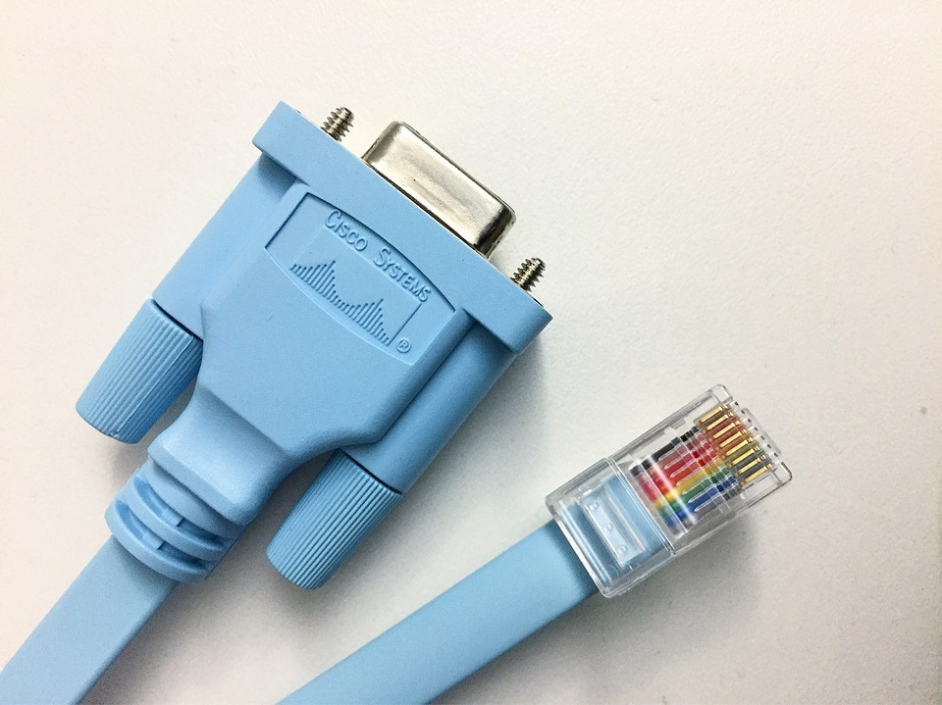
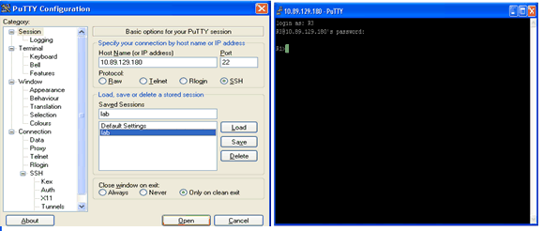
Cisco IOS Access Access Methods
Console – A physical management port used to access a device in order to provide maintenance, such as performing the initial configurations.
Secure Shell (SSH) – Establishes a secure remote CLI connection to a device, through a virtual interface, over a network. (Note: This is the recommended method for remotely connecting to a device.)
Telnet – Establishes an insecure remote CLI connection to a device over the network. (Note: User authentication, passwords and commands are sent over the network in plaintext.)
Notes:
2 – Basic Switch and End Device Configuration
2.1 – Cisco IOS Access
2.1.4 – Access Methods

Slide 20
Cisco IOS Access Terminal Emulation Programs
Terminal emulation programs are used to connect to a network device by either a console port or by an SSH/Telnet connection.
There are several terminal emulation programs to chose from such as PuTTY, Tera Term and SecureCRT.
Notes:
2 – Basic Switch and End Device Configuration
2.1 – Cisco IOS Access
2.1.5 – Terminal Emulation Programs
2.1.6 – Check Your Understanding - Cisco IOS Access

Slide 21
2.2 IOS Navigation
Notes:
2 – Basic Switch and End Device Configuration
2.2 – IOS Navigation

Slide 22
IOS Navigation Primary Command Modes
User EXEC Mode:
Allows access to only a limited number of basic monitoring commands
Identified by the CLI prompt that ends with the > symbol
Privileged EXEC Mode:
Allows access to all commands and features
Identified by the CLI prompt that ends with the # symbol
Notes:
2 – Basic Switch and End Device Configuration
2.2 – IOS Navigation
2.2.1 – Primary Command Modes

Slide 23
IOS Navigation Configuration Mode and Subconfiguration Modes
Global Configuration Mode:
Used to access configuration options on the device
Line Configuration Mode:
Used to configure console, SSH, Telnet or AUX access
Interface Configuration Mode:
Used to configure a switch port or router interface
Notes:
2 – Basic Switch and End Device Configuration
2.2 – IOS Navigation
2.2.2 – Configuration Mode and Subconfiguration Modes

Slide 24
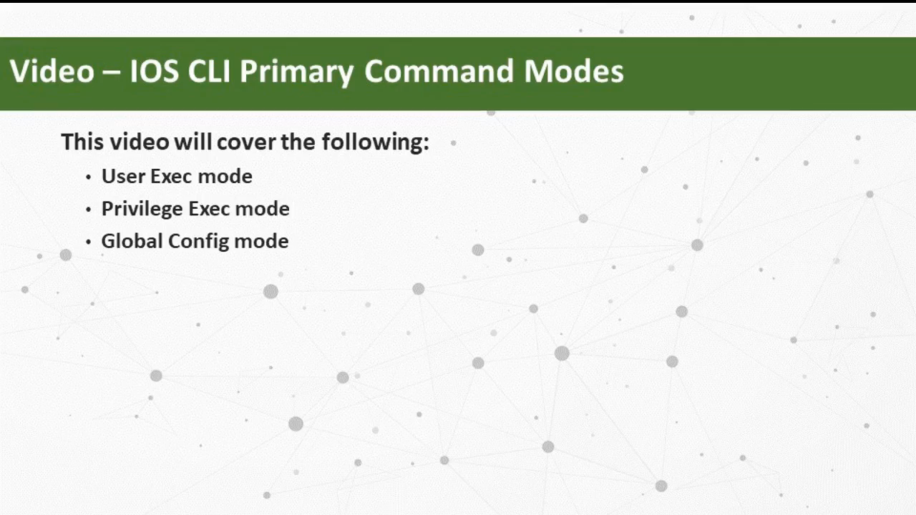
IOS Navigation Video – IOS CLI Primary Command Modes
This video will cover the following:
User EXEC mode
Privilege EXEC mode
Global Config mode
Notes:
2 – Basic Switch and End Device Configuration
2.2 – IOS Navigation
2.2.3 – Video - IOS CLI Primary Command Modes

Slide 25
IOS Navigation Navigation Between IOS Modes
Privileged EXEC Mode:
To move from user EXEC mode to privilege EXEC mode, use the enabled command.
Global Configuration Mode:
To move in and out of global configuration mode, use the configure terminal command. To return to privilege EXEC mode, use the exit command.
Line Configuration Mode:
To move in and out of line configuration mode, use the line command followed by the management line type. To return to global configuration mode, use the exit command.
Notes:
2 – Basic Switch and End Device Configuration
2.2 – IOS Navigation
2.2.4 – Navigate Between IOS Modes

Slide 26
IOS Navigation Navigation Between IOS Modes (Cont.)
Subconfiguration Modes:
To move out of any subconfiguration mode to get back to global configuration mode, use the exit command. To return to privilege EXEC mode, use the end command or key combination Ctrl +Z.
To move directly from one subconfiguration mode to another, type in the desired subconfiguration mode command. In the example, the command prompt changes from (config-line)# to (config-if)#.
Notes:
2 – Basic Switch and End Device Configuration
2.2 – IOS Navigation
2.2.4 – Navigate Between IOS Modes

Slide 27
IOS Navigation Video – Navigation Between IOS Modes
This video will cover the following:
enable
disable
configure terminal
exit
end
Control + Z on keyboard
Other commands to enter sub configuration modes
Notes:
2 – Basic Switch and End Device Configuration
2.2 – IOS Navigation
2.2.5 – Video - Navigate Between IOS Modes
2.2.6 – A Note About Syntax Checker
2.2.7 – Syntax Checker – Navigate Between IOS Modes
2.2.8 – Check Your Understanding - IOS Navigation

Slide 28
2.3 The Command Structure
Notes:
2 – Basic Switch and End Device Configuration
2.3 – The Command Structure

Slide 29
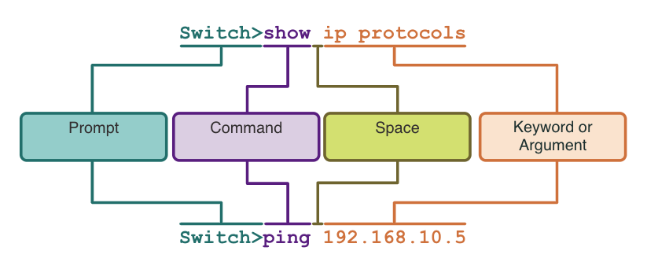
The Command Structure Basic IOS Command Structure
Keyword – This is a specific parameter defined in the operating system (in the figure, ip protocols).
Argument - This is not predefined; it is a value or variable defined by the user (in the figure, 192.168.10.5).
Notes:
2 – Basic Switch and End Device Configuration
2.3 – The Command Structure
2.3.1 – Basic IOS Command Structure

Slide 30
The Command Structure IOS Command Syntax Check
A command might require one or more arguments. To determine the keywords and arguments required for a command, refer to the command syntax.
Boldface text indicates commands and keywords that are entered as shown.
Italic text indicates an argument for which the user provides the value.
Convention | Description
boldface | Boldface text indicates commands and keywords that you enter literally as shown.
italics | Italic text indicates arguments for which you supply values.
[x] | Square brackets indicate an optional element (keyword or argument).
{x} | Braces indicate a required element (keyword or argument).
[x {y | z }] | Braces and vertical lines within square brackets indicate a required choice within an optional element. Spaces are used to clearly delineate parts of the command.
Notes:
2 – Basic Switch and End Device Configuration
2.3 – The Command Structure
2.3.2 – IOS Command Syntax Check

Slide 31
The Command Structure IOS Command Syntax Check (Cont.)
The command syntax provides the pattern, or format, that must be used when entering a command.
The command is ping and the user-defined argument is the ip-address of the destination device. For example, ping 10.10.10.5.
The command is traceroute and the user-defined argument is the ip-address of the destination device. For example, traceroute 192.168.254.254.
If a command is complex with multiple arguments, you may see it represented like this:
Notes:
2 – Basic Switch and End Device Configuration
2.3 – The Command Structure
2.3.2 – IOS Command Syntax Check

Slide 32
The Command Structure IOS Help Features
The IOS has two forms of help available: context-sensitive help and command syntax check.
Context-sensitive help enables you to quickly find answers to these questions:
Which commands are available in each command mode?
Which commands start with specific characters or group of characters?
Which arguments and keywords are available to particular commands?
Command syntax check verifies that a valid command was entered by the user.
If the interpreter cannot understand the command being entered, it will provide feedback describing what is wrong with the command.
Notes:
2 – Basic Switch and End Device Configuration
2.3 – The Command Structure
2.3.3 – IOS Help Features

Slide 33
The Command Structure Video – Context Sensitive Help and Command Syntax Checker
This video will cover the following:
Use the help command in user EXEC, privileged EXEC, and global config mode
Finish commands and arguments with the help command
Use the command syntax checker to fix syntax errors and incomplete commands
Notes:
2 – Basic Switch and End Device Configuration
2.3 – The Command Structure
2.3.4 – Video - Context Sensitive Help and Command Syntax Checker

Slide 34
The Command Structure Hot Keys and Shortcuts
The IOS CLI provides hot keys and shortcuts that make configuring, monitoring, and troubleshooting easier.
Commands and keywords can be shortened to the minimum number of characters that identify a unique selection. For example, the configure command can be shortened to conf because configure is the only command that begins with conf.
Notes:
2 – Basic Switch and End Device Configuration
2.3 – The Command Structure
2.3.5 – Hot Keys and Shortcuts

Slide 35
The Command Structure Hot Keys and Shortcuts (Cont.)
The table below is a brief list of keystrokes to enhance command line editing.
Keystroke | Description
Tab | Completes a partial command name entry.
Backspace | Erases the character to the left of the cursor.
Left Arrow or Ctrl+B | Moves the cursor one character to the left.
Right Arrow or Ctrl+F | Moves the cursor one character to the right.
Up Arrow or Ctrl+P | Recalls the commands in the history buffer, beginning with the most recent commands.
Notes:
2 – Basic Switch and End Device Configuration
2.3 – The Command Structure
2.3.5 – Hot Keys and Shortcuts

Slide 36
The Command Structure Hot Keys and Shortcuts (Cont.)
When a command output produces more text than can be displayed in a terminal window, the IOS will display a “--More--” prompt. The table below describes the keystrokes that can be used when this prompt is displayed.
The table below lists commands that can be used to exit out of an operation.
Keystroke | Description
Enter Key | Displays the next line.
Space Bar | Displays the next screen.
Any other key | Ends the display string, returning to privileged EXEC mode.
Keystroke | Description
Ctrl-C | When in any configuration mode, ends the configuration mode and returns to privileged EXEC mode.
Ctrl-Z | When in any configuration mode, ends the configuration mode and returns to privileged EXEC mode.
Ctrl-Shift-6 | All-purpose break sequence used to abort DNS lookups, traceroutes, pings, etc.
Note: To see more hot keys and shortcuts refer to 2.3.5.
Notes:
2 – Basic Switch and End Device Configuration
2.3 – The Command Structure
2.3.5 – Hot Keys and Shortcuts

Slide 37
The Command Structure Video – Hot Keys and Shortcuts
This video will cover the following:
Tab key (tab completion)
Command shortening
Up and down arrow key
CTRL + C
CTRL + Z
CTRL + Shift + 6
CTRL + R
Notes:
2 – Basic Switch and End Device Configuration
2.3 – The Command Structure
2.3.6 – Video - Hot Keys and Shortcuts

Slide 38
The Command Structure Packet Tracer – Navigate the IOS
In this Packet Tracer, you will do the following:
Establish Basic Connections, Access the CLI, and Explore Help
Explore EXEC Modes
Set the Clock
Notes:
2 – Basic Switch and End Device Configuration
2.3 – The Command Structure
2.3.7 – Packet Tracer – Navigate the IOS

Slide 39
The Command Structure Lab – Navigate the IOS by Using Tera Term for Console Connectivity
In this lab, you complete the following objectives:
Access a Cisco Switch through the Serial Console Port
Display and Configure Basic Device Settings
(Optional) Access a Cisco Router Using a Mini-USB Console Cable
Notes:
2 – Basic Switch and End Device Configuration
2.3 – The Command Structure
2.3.8 – Lab – Navigate the IOS by Using Tera Term for Console Connectivity

Slide 40
2.4 Basic Device Configuration
Notes:
2 – Basic Switch and End Device Configuration
2.4 – Basic Device Configuration

Slide 41
Basic Device Configuration Device Names
The first configuration command on any device should be to give it a unique hostname.
By default, all devices are assigned a factory default name. For example, a Cisco IOS switch is "Switch.”
Guideline for naming devices:
Start with a letter
Contain no spaces
End with a letter or digit
Use only letters, digits, and dashes
Be less than 64 characters in length
Note: To return the switch to the default prompt, use the no hostname global config command.
Notes:
2 – Basic Switch and End Device Configuration
2.4 – Basic Device Configuration
2.4.1 – Device Names

Slide 42

Basic Device Configuration Password Guidelines
The use of weak or easily guessed passwords are a security concern.
All networking devices should limit administrative access by securing privileged EXEC, user EXEC, and remote Telnet access with passwords. In addition, all passwords should be encrypted and legal notifications provided.
Password Guidelines:
Use passwords that are more than eight characters in length.
Use a combination of upper and lowercase letters, numbers, special characters, and/or numeric sequences.
Avoid using the same password for all devices.
Do not use common words because they are easily guessed.
Note: Most of the labs in this course use simple passwords such as cisco or class. These passwords are considered weak and easily guessable and should be avoided in production environments.
Notes:
2 – Basic Switch and End Device Configuration
2.4 – Basic Device Configuration
2.4.2 – Password Guidelines

Slide 43
Basic Device Configuration Configure Passwords
Securing user EXEC mode access:
First enter line console configuration mode using the line console 0 command in global configuration mode.
Next, specify the user EXEC mode password using the password password command.
Finally, enable user EXEC access using the login command.
Securing privileged EXEC mode access:
First enter global configuration mode.
Next, use the enable secret password command.
Notes:
2 – Basic Switch and End Device Configuration
2.4 – Basic Device Configuration
2.4.3 – Configure Passwords

Slide 44
Basic Device Configuration Configure Passwords (Cont.)
Securing VTY line access:
First enter line VTY configuration mode using the line vty 0 15 command in global configuration mode.
Next, specify the VTY password using the password password command.
Finally, enable VTY access using the login command.
Note: VTY lines enable remote access using Telnet or SSH to the device. Many Cisco switches support up to 16 VTY lines that are numbered 0 to 15.
Notes:
2 – Basic Switch and End Device Configuration
2.4 – Basic Device Configuration
2.4.3 – Configure Passwords

Slide 45
Basic Device Configuration Encrypt Passwords
The startup-config and running-config files display most passwords in plaintext.
To encrypt all plaintext passwords, use the service password-encryption global config command.
Use the show running-config command to verify that the passwords on the device are now encrypted.
Notes:
2 – Basic Switch and End Device Configuration
2.4 – Basic Device Configuration
2.4.4 – Encrypt Passwords

Slide 46
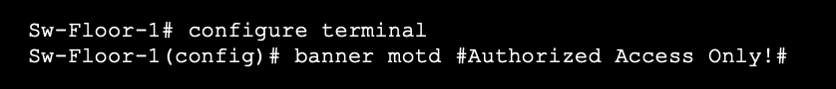
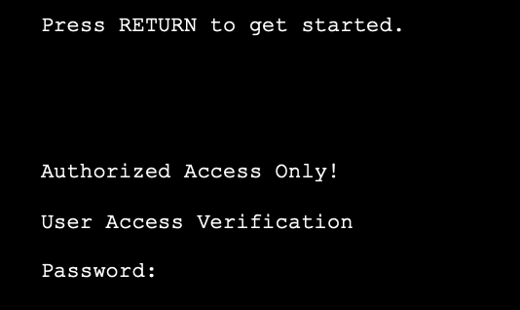
Basic Device Configuration Banner Messages
A banner message is important to warn unauthorized personnel from attempting to access the device.
To create a banner message of the day on a network device, use the banner motd # the message of the day # global config command.
The banner will be displayed on attempts to access the device.
Note: The “#” in the command syntax is called the delimiting character. It is entered before and after the message.
Notes:
2 – Basic Switch and End Device Configuration
2.4 – Basic Device Configuration
2.4.5 – Banner Messages

Slide 47
Basic Device Configuration Video – Secure Administrative Access to a Switch
This video will cover the following:
Access the command line to secure the switch
Secure access to the console port
Secure virtual terminal access for remote access
Encrypt passwords on the switch
Configure the banner message
Verify security changes
Notes:
2 – Basic Switch and End Device Configuration
2.4 – Basic Device Configuration
2.4.6 – Video - Secure Administrative Access to a Switch
2.4.7 – Syntax Checker- Basic Device Configuration
2.4.8 – Check Your Understanding - Basic Device Configuration

Slide 48
2.5 Save Configurations
Notes:
2 – Basic Switch and End Device Configuration
2.5 – Save Configurations

Slide 49
Save Configurations Configuration Files
There are two system files that store the device configuration:
startup-config - This is the saved configuration file that is stored in NVRAM. It contains all the commands that will be used by the device upon startup or reboot. Flash does not lose its contents when the device is powered off.
running-config - This is stored in Random Access Memory (RAM). It reflects the current configuration. Modifying a running configuration affects the operation of a Cisco device immediately. RAM is volatile memory. It loses all of its content when the device is powered off or restarted.
To save changes made to the running configuration to the startup configuration file, use the copy running-config startup-config privileged EXEC mode command.
Notes:
2 – Basic Switch and End Device Configuration
2.5 – Save Configurations
2.5.1 – Configuration Files

Slide 50
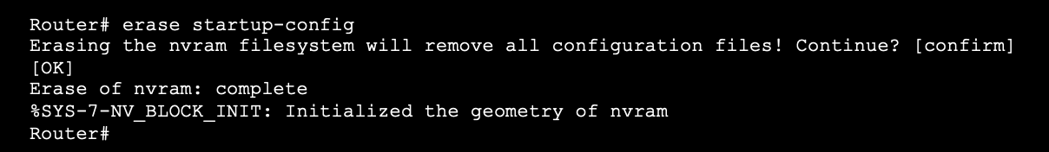
Save Configurations Alter the Running Configurations
If changes made to the running config do not have the desired effect and the running-config has not yet been saved, you can restore the device to its previous configuration. To do this you can:
Remove the changed commands individually.
Reload the device using the reload command in privilege EXEC mode. Note: This will cause the device to briefly go offline, leading to network downtime.
If the undesired changes were saved to the startup-config, it may be necessary to clear all the configurations using the erase startup-config command in privilege EXEC mode.
After erasing the startup-config, reload the device to clear the running-config file from RAM.
Notes:
2 – Basic Switch and End Device Configuration
2.5 – Save Configurations
2.5.2 – Alter the Running Configuration

Slide 51
Save Configurations Video – Alter the Running Configuration
This video will cover the following:
Copy the running-config file to the startup-config file
Show the files in the flash or NVRAM directory
Use command shortening
Erase the startup-config file
Copy the start-config file to the running-config file
Notes:
2 – Basic Switch and End Device Configuration
2.5 – Save Configurations
2.5.3 – Video - Alter the Running Configuration

Slide 52
Save Configurations Capture Configuration to a Text File
Configuration files can also be saved and archived to a text document.
Step 1. Open terminal emulation software, such as PuTTY or Tera Term, that is already connected to a switch.
Step 2. Enable logging in to the terminal software and assign a name and file location to save the log file. The figure displays that All session output will be captured to the file specified (i.e., MySwitchLogs).
Notes:
2 – Basic Switch and End Device Configuration
2.5 – Save Configurations
2.5.4 – Capture Configuration to a Text File

Slide 53

Save Configurations Capture Configuration to a Text File (Cont.)
Step 3. Execute the show running-config or show startup-config command at the privileged EXEC prompt. Text displayed in the terminal window will be placed into the chosen file.
Step 4. Disable logging in the terminal software. The figure shows how to disable logging by choosing the None session logging option
Note: The text file created can be used as a record of how the device is currently implemented. The file could require editing before being used to restore a saved configuration to a device.
Notes:
2 – Basic Switch and End Device Configuration
2.5 – Save Configurations
2.5.4 – Capture Configuration to a Text File

Slide 54
Save Configurations Packet Tracer – Configure Initial Switch Settings
In this Packet Tracer, you will do the following:
Verify the Default Switch Configuration
Configure a Basic Switch Configuration
Configure a MOTD Banner
Save Configuration Files to NVRAM
Configure a second Switch
Notes:
2 – Basic Switch and End Device Configuration
2.5 – Save Configurations
2.5.5 – Packet Tracer – Configure Initial Switch Settings

Slide 55
2.6 Ports and Addresses
Notes:
2 – Basic Switch and End Device Configuration
2.6 – Ports and Addresses

Slide 56
Ports and Addresses IP Addresses
The use of IP addresses is the primary means of enabling devices to locate one another and establish end-to-end communication on the internet.
The structure of an IPv4 address is called dotted decimal notation and is represented by four decimal numbers between 0 and 255.
An IPv4 subnet mask is a 32-bit value that differentiates the network portion of the address from the host portion. Coupled with the IPv4 address, the subnet mask determines to which subnet the device is a member.
The default gateway address is the IP address of the router that the host will use to access remote networks, including the internet.
Notes:
2 – Basic Switch and End Device Configuration
2.6 – Ports and Addresses
2.6.1 – IP Addresses

Slide 57
Ports and Addresses IP Addresses (Cont.)
IPv6 addresses are 128 bits in length and written as a string of hexadecimal values. Every four bits is represented by a single hexadecimal digit; for a total of 32 hexadecimal values. Groups of four hexadecimal digits are separated by a colon “:”.
IPv6 addresses are not case-sensitive and can be written in either lowercase or uppercase.
Note: IP in this course refers to both the IPv4 and IPv6 protocols. IPv6 is the most recent version of IP and is replacing the more common IPv4.
Notes:
2 – Basic Switch and End Device Configuration
2.6 – Ports and Addresses
2.6.1 – IP Addresses

Slide 58
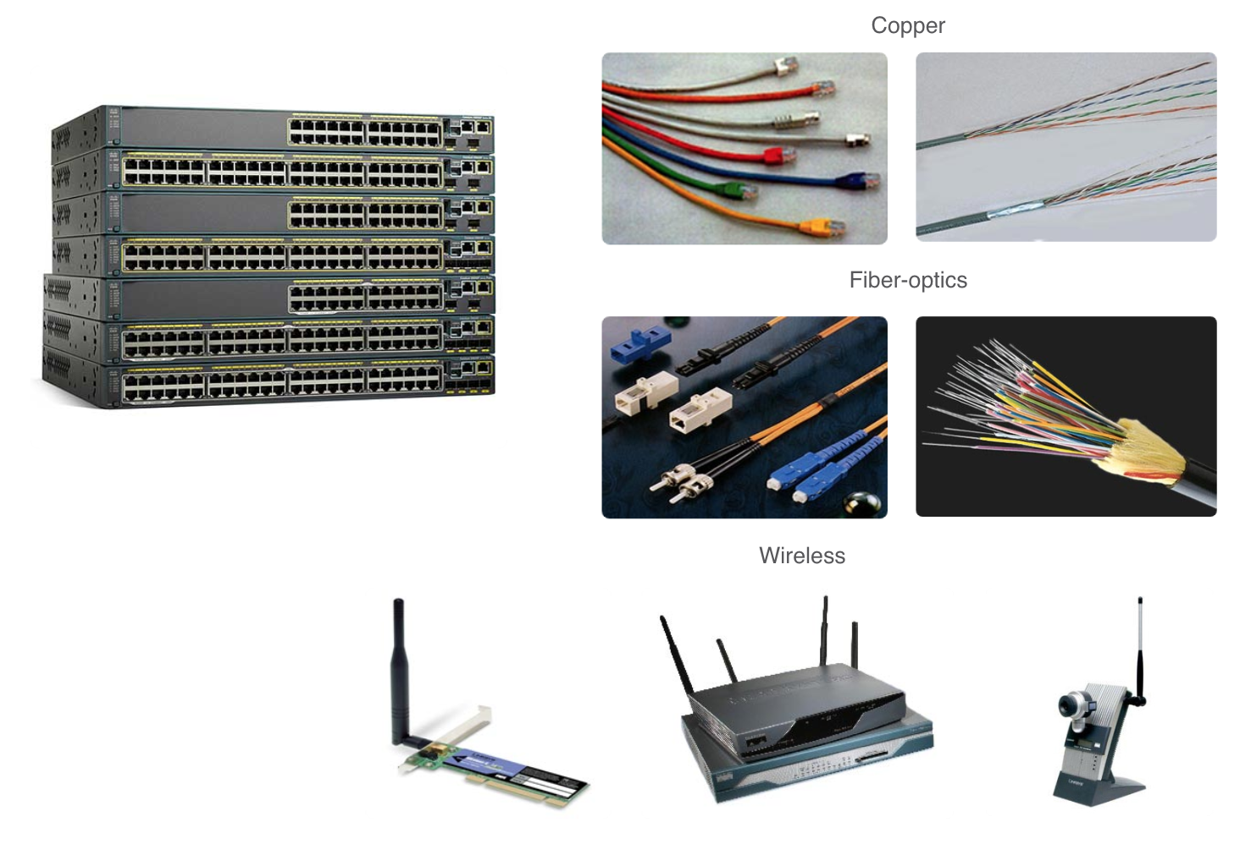
Ports and Addresses Interfaces and Ports
Network communications depend on end user device interfaces, networking device interfaces, and the cables that connect them.
Types of network media include twisted-pair copper cables, fiber-optic cables, coaxial cables, or wireless.
Different types of network media have different features and benefits. Some of the differences between various types of media include:
Distance the media can successfully carry a signal
Environment in which the media is to be installed
Amount of data and the speed at which it must be transmitted
Cost of the media and installation
Notes:
2 – Basic Switch and End Device Configuration
2.6 – Ports and Addresses
2.6.2 – Interfaces and Ports
2.6.3 – Check Your Understanding - Ports and Addresses

Slide 59
2.7 Configure IP Addressing
Notes:
2 – Basic Switch and End Device Configuration
2.7 – Configure IP Addressing

Slide 60
Configure IP Addressing Manual IP Address Configuration for End Devices
End devices on the network need an IP address in order to communicate with other devices on the network.
IPv4 address information can be entered into end devices manually, or automatically using Dynamic Host Configuration Protocol (DHCP).
To manually configure an IPv4 address on a Windows PC, open the Control Panel > Network Sharing Center > Change adapter settings and choose the adapter. Next right-click and select Properties to display the Local Area Connection Properties.
Next, click Properties to open the Internet Protocol Version 4 (TCP/IPv4) Properties window. Then configure the IPv4 address and subnet mask information, and default gateway.
Note: IPv6 addressing and configuration options are similar to IPv4.
Notes:
2 – Basic Switch and End Device Configuration
2.7 – Configure IP Addressing
2.7.1 – Manual IP Address Configuration for End Devices

Slide 61
Configure IP Addressing Automatic IP Address Configuration for End Devices
DHCP enables automatic IPv4 address configuration for every end device that is DHCP-enabled.
End devices are typically by default using DHCP for automatic IPv4 address configuration.
To configure DHCP on a Windows PC, open the Control Panel > Network Sharing Center > Change adapter settings and choose the adapter. Next right-click and select Properties to display the Local Area Connection Properties.
Next, click Properties to open the Internet Protocol Version 4 (TCP/IPv4) Properties window, then select Obtain an IP address automatically and Obtain DNS server address automatically.
Note: IPv6 uses DHCPv6 and SLAAC (Stateless Address Autoconfiguration) for dynamic address allocation.
Notes:
2 – Basic Switch and End Device Configuration
2.7 – Configure IP Addressing
2.7.2 – Automatic IP Address Configuration for End Devices
2.7.3 – Syntax Checker – Verify Windows PC IP Configuration

Slide 62
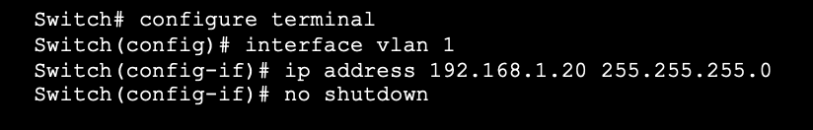
Configure IP Addressing Switch Virtual Interface Configuration
To access the switch remotely, an IP address and a subnet mask must be configured on the SVI.
To configure an SVI on a switch:
Enter the interface vlan 1 command in global configuration mode.
Next assign an IPv4 address using the ip address ip-address subnet-mask command.
Finally, enable the virtual interface using the no shutdown command.
Notes:
2 – Basic Switch and End Device Configuration
2.7 – Configure IP Addressing
2.7.4 – Switch Virtual Interface Configuration
2.7.5 – Syntax Checker – Configure a Switch Virtual interface

Slide 63
Configure IP Addressing Packet Tracer – Implement Basic Connectivity
In this Packet Tracer, you will do the following:
Perform a Basic Configuration on two switches
Configure the PCs
Configure the Switch Management Interface
Notes:
2 – Basic Switch and End Device Configuration
2.7 – Configure IP Addressing
2.7.6 – Packet Tracer – Implement Basic Connectivity

Slide 64
2.8 Verify Connectivity
Notes:
2 – Basic Switch and End Device Configuration
2.8 – Verify Connectivity

Slide 65
Verify Connectivity Video – Test the Interface Assignment
This video will cover the following:
Connect a console cable from the PC to the switch
Use the terminal emulation program and accept the defaults to bring you to the command line
Use enable to enter privileged EXEC mode
Use the global configuration mode and the interface configuration mode to enter the no shutdown command
Notes:
2 – Basic Switch and End Device Configuration
2.8 – Verify Connectivity
2.8.1 – Video - Test the Interface Assignment

Slide 66
Verify Connectivity Video – Test End-to-End Connectivity
This video will cover the use of the ping command to test connectivity on both switches and both PCs.
Notes:
2 – Basic Switch and End Device Configuration
2.8 – Verify Connectivity
2.8.2 – Video - Test End-to-End Connectivity

Slide 67
2.9 Module Practice and Quiz
Notes:
2 – Basic Switch and End Device Configuration
2.9 – Module Practice and Quiz

Slide 68
Module Practice and Quiz Packet Tracer – Basic Switch and End Device Configuration
In this Packet Tracer, you will do the following: 2.9.1
Configure hostnames and IP addresses on two switches
Use Cisco IOS commands to specify or limit access to the device configurations
Use IOS commands to save the running configuration
Configure two host devices with IP addresses
Verify connectivity between the two PC end devices
Notes:
2 – Basic Switch and End Device Configuration
2.9 – Module Practice and Quiz
2.9.1 – Packet Tracer – Basic Switch and End Device Configuration

Slide 69
Module Practice and Quiz Lab – Basic Switch and End Device Configuration
In this lab, you complete the following objectives:
Set Up the Network Topology
Configure PC Hosts
Configure and Verify Basic Switch Settings
Notes:
2 – Basic Switch and End Device Configuration
2.9 – Module Practice and Quiz
2.9.2 – Lab – Basic Switch and End Device Configuration

Slide 70
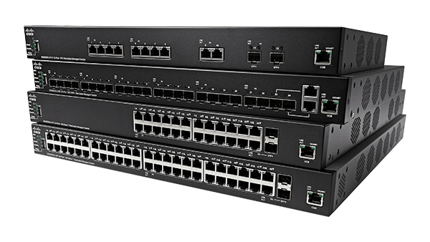
Module Practice and Quiz What did I learn in this module?
All end devices and network devices require an operating system (OS).
Cisco IOS software separates management access into the following two command modes: User EXEC Mode and Privileged EXEC Mode.
Global configuration mode is accessed before other specific configuration modes. From global config mode, the user can enter different subconfiguration modes.
Each IOS command has a specific format or syntax and can only be executed in the appropriate mode.
Basic device configurations- hostname, password, encrypt passwords and banner.
There are two system files that store the device configuration: startup-config and running-config.
IP addresses enable devices to locate one another and establish end-to-end communication on the internet. Each end device on a network must be configured with an IP address.
Notes:
2 – Basic Switch and End Device Configuration
2.9 – Module Practice and Quiz
2.9.3 – What did I learn in this module?
2.9.4 – Module Quiz - Basic Switch and End Device Configuration

Slide 71
Module 2 : Basic Switch and End Device Configuration New Terms and Commands
operating system (OS) CLI GUI shell kernel hardware console Secure Shell (SSH) Telnet terminal emulation programs user EXEC mode privileged EXEC mode | line configuration mode interface configuration mode Enable configure terminal exit end argument keyword command syntax ping traceroute help command ”?” hot keys hostname | console enable secret VTY line show running-config banner motd startup-config running-config reload erase startup-config DHCP switch virtual interface (SVI) ipconfig show ip int brief
Notes:
2 – Basic Switch and End Device Configuration
New Terms and Commands

